Slide 1
Two objectives
Model things unrelated to heritability, but control for dependence structure due to genetic relatedness.
e.g. Prodicaine and temperature effects, relationship between modality and prodicaine, etc.
Prototypical question: “how well does the prodicaine effect generalize from the conditioned modality (thermal pain) to a new stimulus modality?”, “what is the mean response of this brain voxel”
Linear modeling (e.g. linear mixed effects model) of a continuous observed outcome variable (pain report, BOLD response, etc).
Model heritability of behavior.
Suppose you have placebo effects estimated for each subject. How correlated are they among twin pairs? Is this correlation stronger for monozygotes than dizygotes, and if so how much stronger?
Linear modeling (ACDE model) of an estimate (e.g. covariance as function of genetic relatedness and common environment)

Slide 2
Overview
Theory
Mixed modeling vs. alternatives
Random effects structure
How do you implement these in off the shelf tools?
Example application to partial dataset
Simulations
Heritability an intercept only case
Intercept, temperature and prodicaine

Slide 3
Theory of twin modeling in a GLM framework

Slide 4
Assumptions underlying the heritability analysis
Dizygotes share ~½ of the heritability of monozygotes****
equal shared environmental influences across different monozygotic and dizygotic families****
there’s little or no assortative mating
hardy weinberg equilibrium (stationarity across generations)
no epistasis (interactions between alleles at different loci)
absence of gene-environment interaction

Slide 5
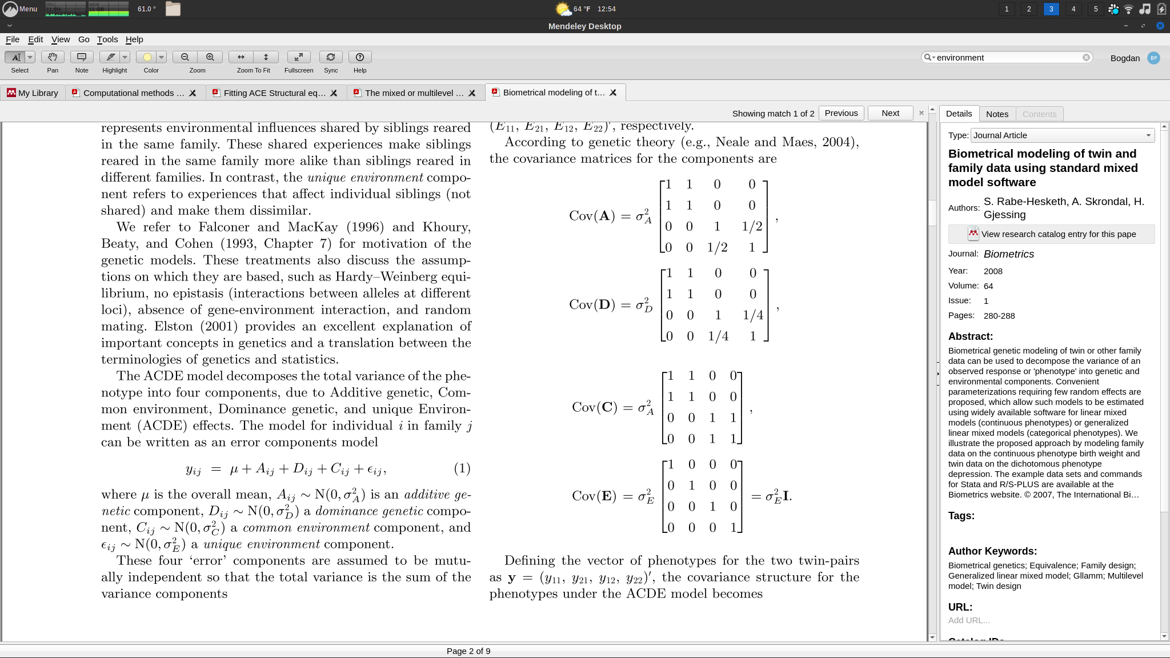
These models take two forms.
Mixed model:
Y = XB + Zu + e
u ~ N(0, Σ)
e ~ N(0,σ²W)
typically W = I, Z is block diagonal by grouping (e.g. subject or family).
Twin dependence structure described by Σ and σ²W
SEM model:
Y= b + A + C + e
A ~ N(0, cov(A))
C ~ N(0, cov(C))
e ~ N(0,σ²I)
Twin dependence structure described by cov(A), cov(C), σ²
(2 twin pairs, first is MZ, second is DZ)
Guo & Wang (2002)
Rabe-Hesketh, et al. (2008)

Slide 6
These slides focus on the mixed modeling approach
Advantages:
Familiarity
Software implementations are more widely available
Easier to solve the first objective (control for dependence structure)
Disadvantages:
Cannot impose restrictions on covariance structure predicted by genetic theory (e.g. dizygotes could show greater dependence than monozygotes)
No parametric inference of heritability effects. Must use resampling techniques.

Slide 7
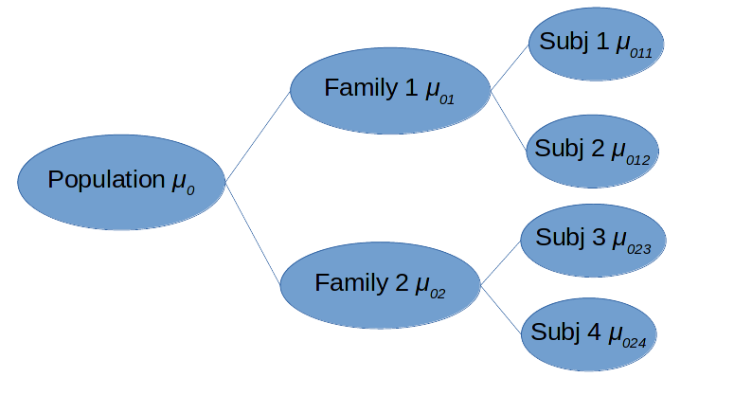
Structure of intercept only gLME model (suppose we’re modeling mean pain response)
A simpler version of this model has a single level of random effects, and heteroscedastic error variance, for when we have subject level observations (e.g. a disease state)
Y_{i} = μ₀ + u_{f} + e_{i}
We have estimates from repeated measures (like temperature of placebo effects), but we could treat them as obs and fit this model in R.
Y_{i} = μ₀ + u_{f} + u_{s(t)} + e_{i}
u_{f} ~ N(0,σ²_{f})
u_{s(mz)} ~ N(0,σ²_{mz}), u_{s(dz)} ~ N(0,σ²_{dz})
e ~ N(0, σ²)
Family will explain different amounts of variance for dizygotic twins than monozygotic twins, so subject effects must be heteroscedastic

Slide 8
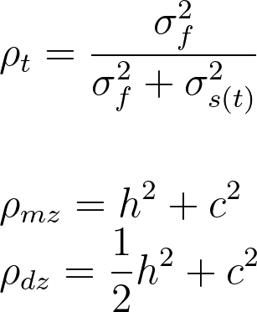
Heteroscedasticity is ESSENTIAL
The mixed model hypothesizes that twin pairs will correlate with one another in their mean outcome. If they don’t σ_{f} = 0
This correlation may arise due to common environmental effects (same uterine environment, like same childhood home, same parents, etc), or due to genetic factors
Genetic theory tells us that monozygotic twins should correlate more strongly than dizygotic twins if measured outcome has heritable genetic component
We can quantify the heritability (A) and common environment (C) factors of mean effects like so.
Finally E = 1 - ρ is the unique environmental effect (from ACE).
Notes:
\\ \rho_{t} = \frac{\sigma^2_f}{\sigma^2_f + \sigma^2_{s(t)}} \\ \\ \\
\rho_{mz} = h^2 + c \\
\rho_{dz} = \frac{1}{2} h^2 + c

Slide 9
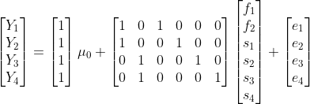
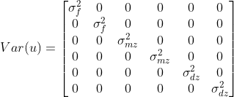

Parameterization for LME, using 2fam x 4subj exp.
X b Z u e
n = number of obs
ns = number of subject
nf = number of families
Y = Xb + Zu + e
Y₁ = μ₀ + f₁ + s_{1(mz)} + e₁
Y₂ = μ₀ + f₁ + s_{2(mz)} + e₂
Y₃ = μ₀ + f₂ + s_{3(dz)} + e₃
Y₄ = μ₀ + f₂ + s_{4(dz)} + e₄

Slide 10
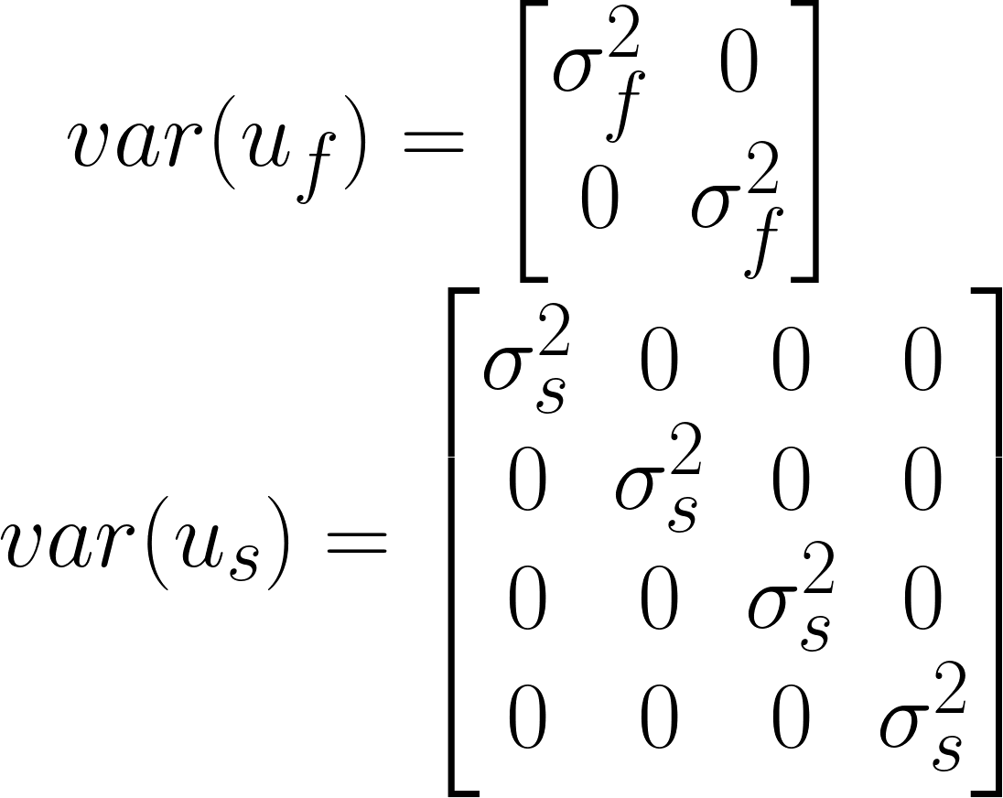
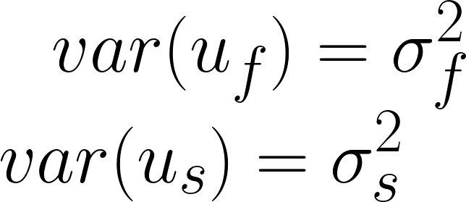
Parameterization for fitlme() and LME4
Both fitlme() (matlab) and LME4 allow for nested random effects
Y = Xb + Z_{f}u_{f} + Z_{s}u_{s} + e
You just need to be able to
Express Z as block diagonal matrices of n submatrices of size m x p
where n are your levels, m are your observations per level, and p are the number of random effects you model,
Express var(u_{i}) as a p x p covariance matrix that is homogenous across blocks of Z_{i}.
We’ve already solved 1,
But if we use this formulation we’re forced to use
Which doesn’t model heteroscedasticity of zygosity, essential for modeling heritability

Slide 11
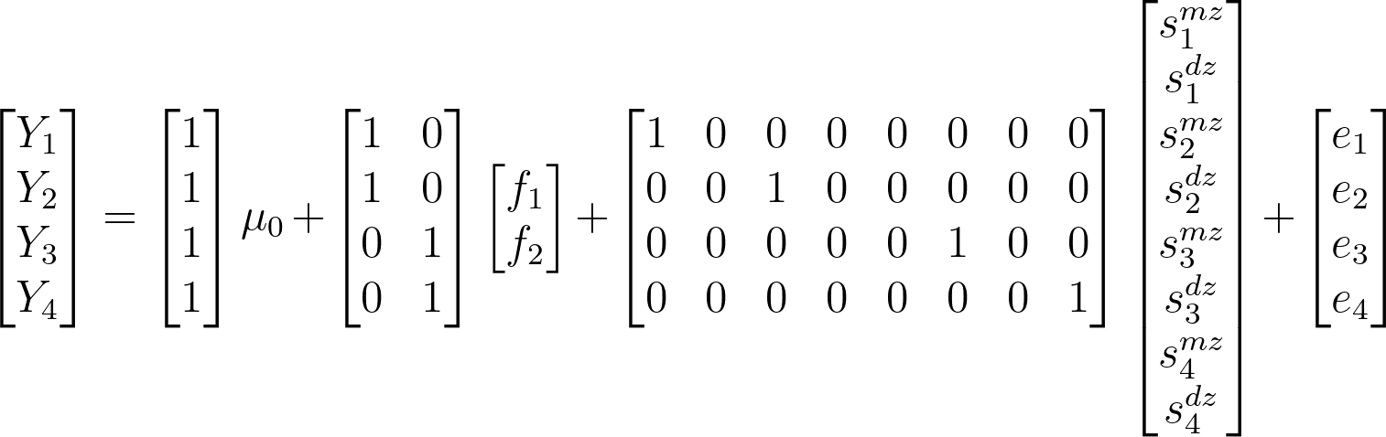
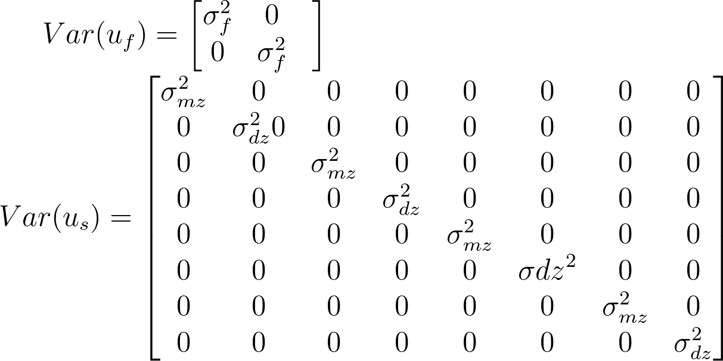
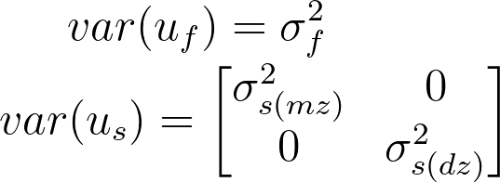
Parameterization for fitlme() and LME4
We solve this problem by introducing dummy variables for every subject block
Notes:
\begin{bmatrix} Y_1\\Y_2\\Y_3\\Y_4 \end{} = \begin{bmatrix} 1\\1\\1\\1 \end{}\mu_0 + \begin{bmatrix} 1&0\\1&0\\0&1\\0&1 \end{}\begin{bmatrix}f_1\\f_2 \end{} +\begin{bmatrix}1 & 0 & 0 & 0 & 0 & 0 & 0 & 0 \\ 0 & 0 & 1 & 0 & 0 & 0 & 0 & 0 \\ 0 & 0 & 0 & 0 & 0 & 1 & 0 & 0 \\ 0 & 0 & 0 & 0 & 0 & 0 & 0 & 1\end{} \begin{bmatrix} s_1^{mz}\\s_1^{dz}\\s_2^{mz}\\s_2^{dz}\\s_3^{mz}\\s_3^{dz}\\s_4^{mz}\\s_4^{dz}\end{} + \begin{bmatrix}e_1\\e_2\\e_3\\e_4\end{}

Slide 12
Example application to real data

Slide 13
Data description
We have twin pairs subject to painful thermal and mechanical stimuli with and without a placebo treatment called “prodicaine”. Subjects rate their perceived pain intensity on a bartoshuk scale after each stimulus. Placebo effects are reinforced through a classical and symbolic conditioning paradigm prior to testing, but only using thermal stimuli. Here we will investigate only the thermal stimulus responses.
Outcome - skewed pain rating distribution
StimLvl - {46.5, 47, 47.5C} x 10s thermal stimuli
Placebo - {0,1}

Slide 14
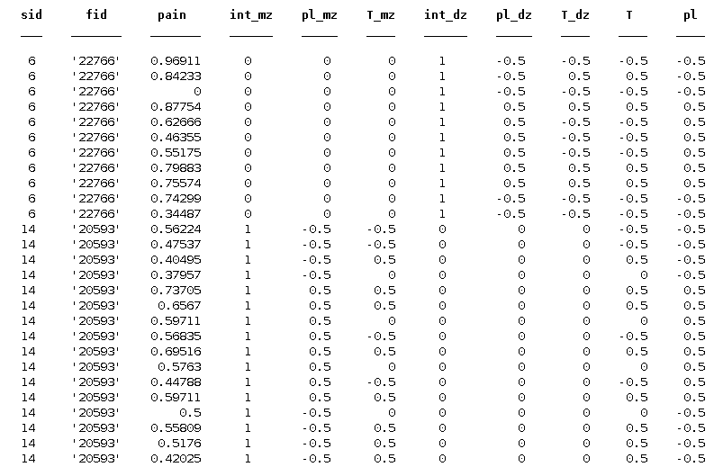
Dataset description (first rows of heat_t table shown)
sid - subject ID
fid - family ID
Variables used to model fixed effects and family random effects:
T - temperature (46.5, 47, 47.5, centered)
pl - placebo (0, 1, centered)
(Intercept is a unit vector, and automatically when fitting model)
Variables used to model subject random effects, which need to be modeled with difference variance depending on zygosity:
int_mz - intercept for monozygotes
Pl_mz - placebo treatment for monozygotes (0,1, centered)
T_mz - stimulus level (46.5, 47, 47.5 centered) for monozygotes
*_dz - same as above only for dizygotes

Slide 15
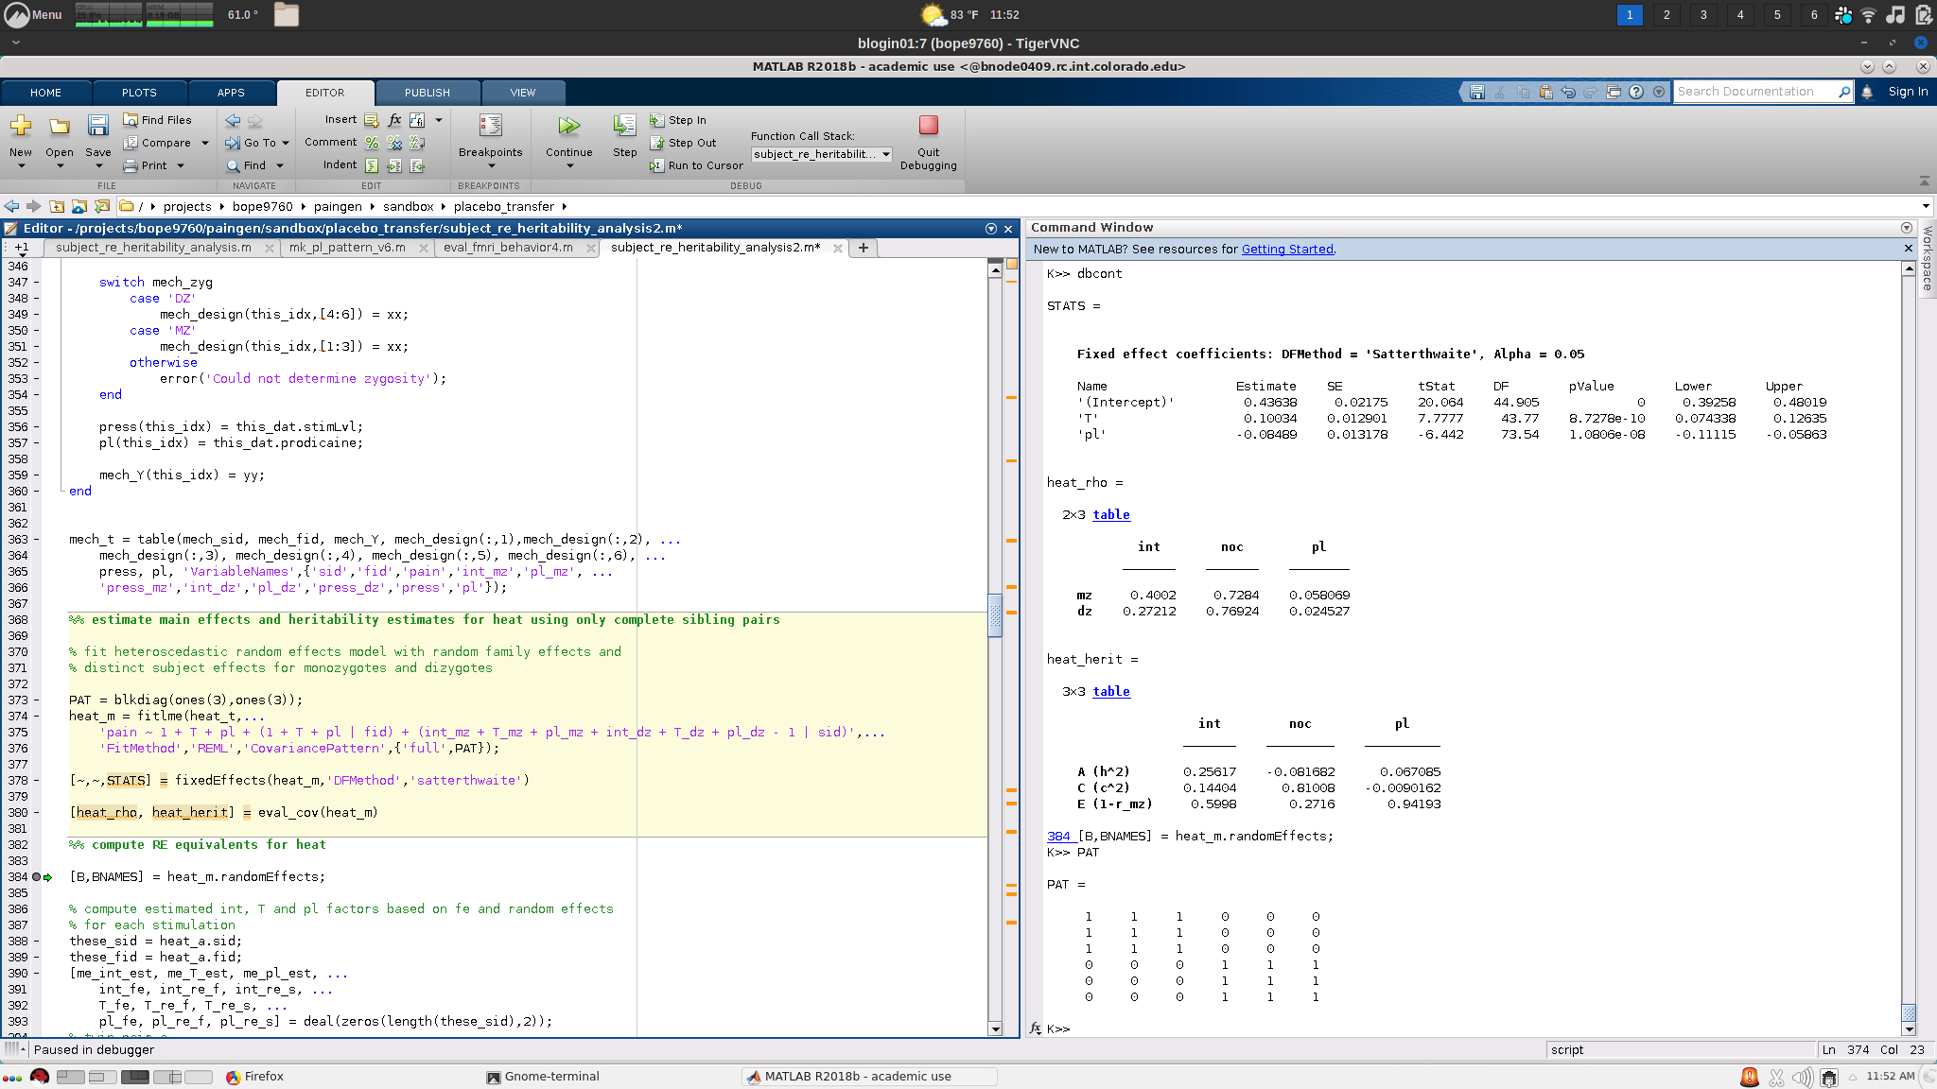
Model specification/implementation

Slide 16
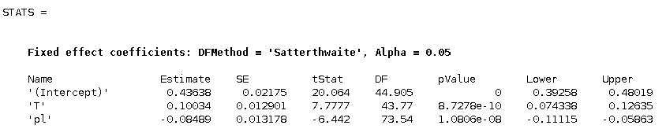
Obtaining correct estimates and p-values that generalize to individuals from new families

Slide 17
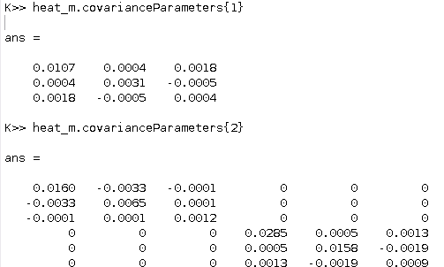
Heritability is computed using values from random effects covariance matrices
Given covariance parameters we can solve for h and c:
Covariance matrices don’t have labels indicating which variables each element belongs to. The order of variables will match the order they’re listed in your data table (heat_t here), NOT the order entered in your fitlme formula.
intercept
T
pl
int_mz pl_mz T_mz int_dz pl_dz T_dz

Slide 18
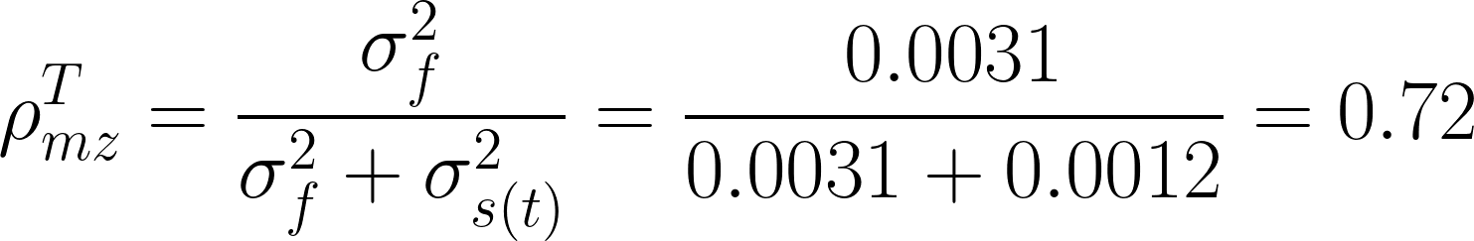
Computing correlations of random effects
One example:
intercept
T
pl
We can repeat this for every variable:
Nociception, i.e. T
int_mz pl_mz T_mz int_dz pl_dz T_dz

Slide 19
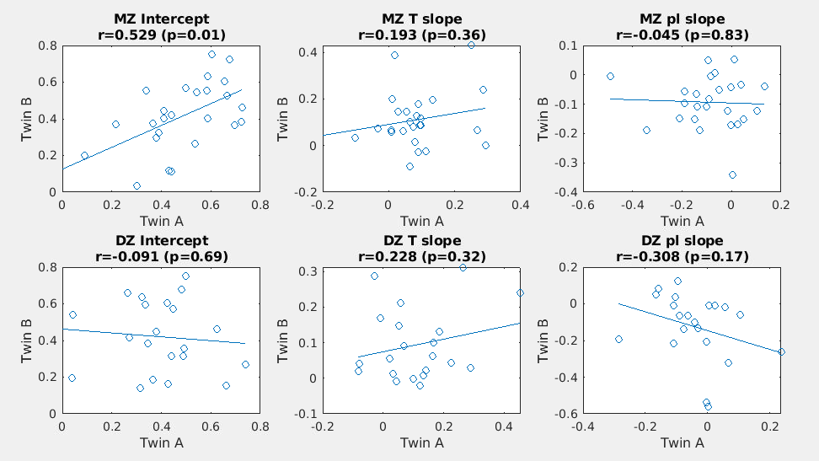
We can fit separate models for each subject and compute correlations of estimates within twin pairs too,
Each point is a twin pair. Results differ substantially from covariance estimates of the model. This is due to two factors. (1) mixed modeling estimates subject level effects jointly, which regularizes and shrinks estimates and (2) variation of a sample overestimates variance of population, which covariance parameters correct for. We will use simulations to show that in fact the mixed model covariance estimates best recover population correlations.

Slide 20
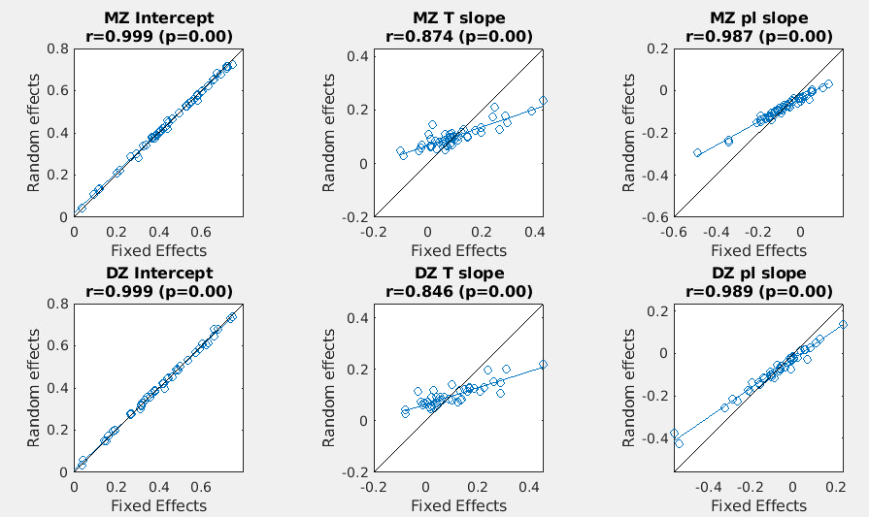
Mixed model shrinks subject level effect estimates
Mixed models assume that random effects are jointly normal (i.e. they fit a multivariate normal distribution). Under this prior assumption, values that deviate substantially from the mean are unlikely, so maximum likelihood solutions from mixed models will yield smaller values that those obtained from maximum likelihood solutions of data fit for each subject separately.

Slide 21
Heritability can be computed from rho by solving a linear equation.
Confidence intervals can be computed using a bias corrected and accelerated bootstrap procedure. Resample families and repeat model fitting for each family (slow). Save results to get your distribution. Resultant distributions are likely to be skewed so BCa bootstrap is essential.

Slide 22
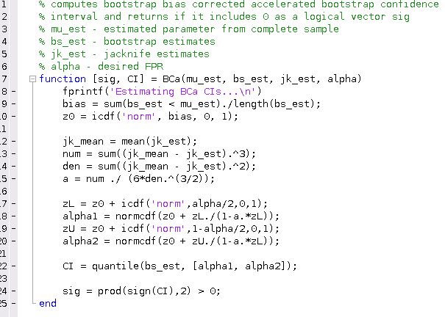
Example code for computing CI using BCa bootstrap
Takes bootstrap and jackknife estimates as user supplied input, allowing you to resample according to whatever level of generalization you like, but here you should be resampling families. If you resample observations you should get the same results as using matlab’s built in bootci method.

Slide 23
Simulations

Slide 24
Use estimated parameters as ground truth
For our simulations we need some true parameter values, a design matrix, and randomly generated noise that abides by the twin design noise structure. The goal is to see how well we can recover the true parameter values using our model fitting algorithm (REML) as implemented by fitlme() in matlab. Presumably (if the matlab engineers did their job) we should be able to recover the true values given sufficient data, but in practice the amount of data required scales with the complexity of our model, and our model is quite complex, so we want to establish that we can recover the true values (and quantify how precisely we can recover them) given the amount of data we expect to obtain in the paingen study.
We will generate outcome data (pain ratings) for 200 hundred twin pairs (400 subjects). Our design matrix will assume 16 observations per subject, 3x 46.5, 2x 47, and 3x 47.5 C stimuli for each of a placebo treated and a control treated condition. Half will be monozygotic, and half will be dizygotic. The random noise we add will be drawn from a random normal distribution with multivariate random family and subject effects (but family and subject are independent of one another), and normally distributed observation error. Where there is some leeway in the selection of ground truth parameter values (e.g. fixed effect of temperature of placebo treatment, covariance structure of random effects, etc), we may adopt the parameter values obtained from our preliminary sample, or otherwise use values loosely based off of the same.

Slide 25
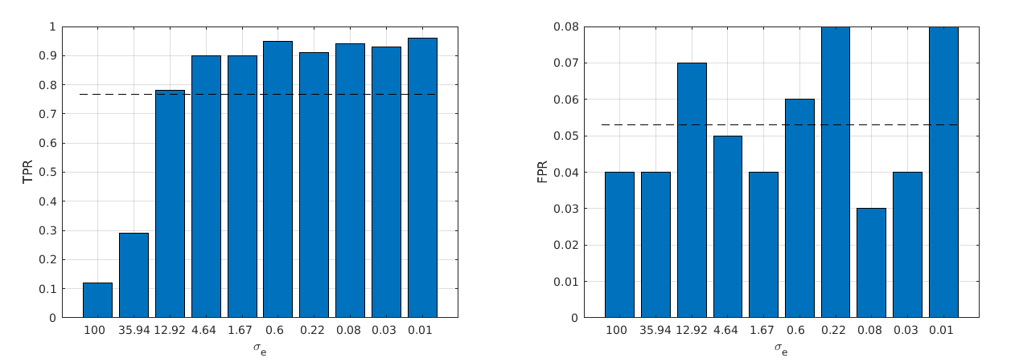
TPR and FPR for fixed effects as a fxn of obs noise
We perform 100 simulations at each level of sigma_e (which is on a log scale) and evaluate whether a true effect has p < 0.05 (TPR) and whether a null effect has a p < 0.05 (FPR). Results show good control on FPR, and noise dependent TPR. Here the T effect is nonzero and positive, while the placebo effect is zero. Covariances random positive-semidefinite matrices with unit diagonal computed as a normalized product of C’*C where C is a matrix of chi-square(3) random variables. rho_mz is 0.40, and rho_dz is 0.28 for all random effects.

Slide 27
Let’s do some simulations using this data structure,
Y = b + Z_{f}u_{f} + Z_{s}u_{s(t)} + e
u_{f} ~ N(0, σ_{f}²)
u_{s(t)} ~ N(0, σ_{s(t)}²)
e ~ N(0, σ_{e}²)
σ_{s(t)}² =(1-ρ_{s(t)})/ρ_{s(t)}*σ_{f}²
σ_{e} = 1/SNR * std(Xb + Z_{f}u_{f} + Z_{s}u_{s(t)})
b ~ unif(-2.5, 2.5)
σ_{f} ~ χ²(3)
ρ_{mz,} ρ_{dz} ~ unif(0,1)
SNR = int([1,10])
Families = 200
Subjects = 2/family
Stimuli = 16/subject
No covariates
Because we have no covariates our only objective is to estimate covariance parameters
Note: what SNR means. Take SNR = 2. It says that the variation you get from a single subject’s ratings (for a fixed stimulus) might be equal to half the variation you get in mean ratings between subjects. In practice I suspect we’re in the 1-3 range.
Change of variables allows us to sample evenly across heritability space

Slide 28
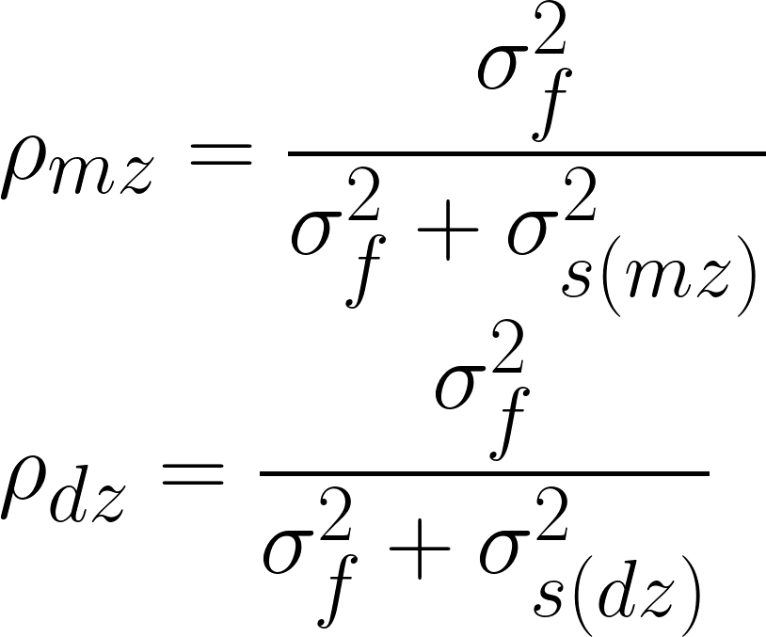
5d space, but only 3 we care about. We integrate over random samples of the rest
Free parameters
(b, σ_{f}, σ_{s(mz)}, σ_{s(dz)}, SNR)
We care about b, and the b-independent variables
We care about SNRs 1-10
For variables which don’t depend on b:
Fix b, sample evenly from 1-10 SNR and from 0.1-0.9 ρ_{s(mz)} and uniformly 0-1 for ρ_{s(dz)}
Motivating question: How well can we estimate small ρ? Large ρ? How does this depend on SNR or ρ_{s(dz)}?
We’ll hold off on evaluating b for now because it’s a bit trivial here

Slide 29
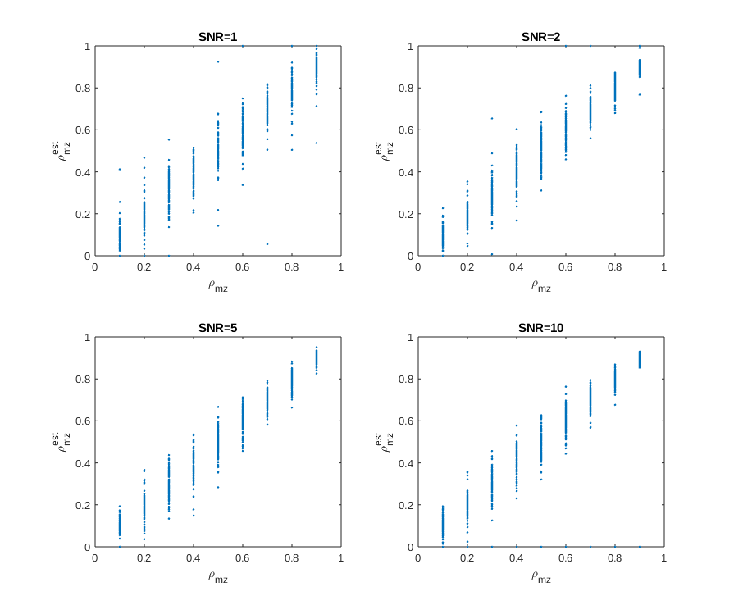
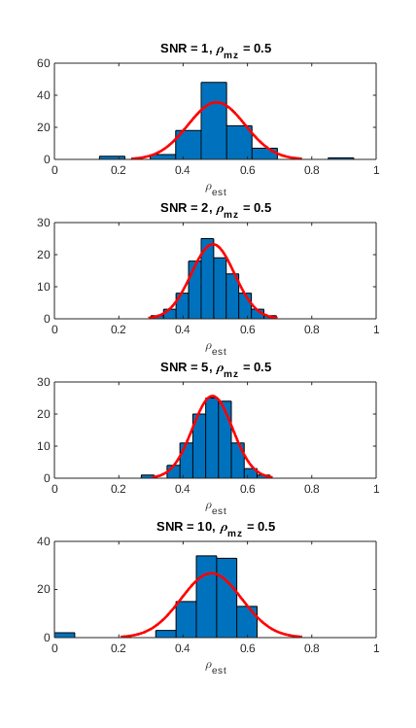
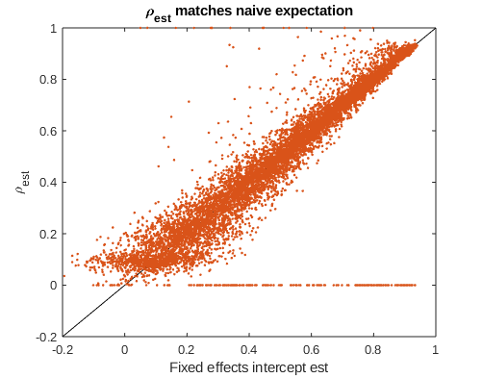
Turns out not to depend on SNR
Not shown, but ρ_{s(mz)} is independent of ρ_{s(dz)}
Model failed to converge here, but algorithm can be tweaked as needed

Slide 30
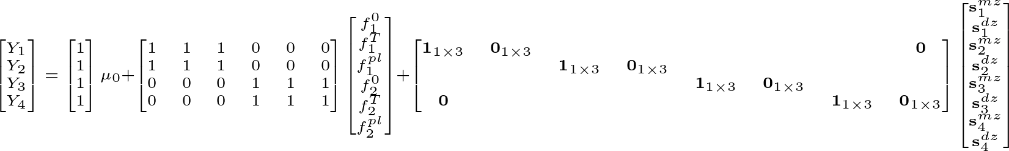

Generalizing to models with 3 random effects (e.g. T and prodicaine)
Notes:
\begin{bmatrix} Y_1\\Y_2\\Y_3\\Y_4 \end{} = \begin{bmatrix} 1\\1\\1\\1 \end{}\mu_0 + \begin{bmatrix} 1&1&1&0&0&0\\1&1&1&0&0&0\\0&0&0&1&1&1\\0&0&0&1&1&1 \end{}\begin{bmatrix}f_1^0\\f_1^T\\f_1^{pl}\\f_2^0\\f_2^T\\f_2^{pl} \end{} +\begin{bmatrix} \textbf{1}_{1\times 3} & \textbf{0}_{1\times 3} &&&&&&\textbf{0}\\ & & \textbf{1}_{1\times 3} & \textbf{0}_{1\times 3} \\ & & & & \textbf{1}_{1\times 3} & \textbf{0}_{1\times 3} \\ \textbf{0}&&&&&&\textbf{1}_{1\times 3} & \textbf{0}_{1\times 3}\end{} \begin{bmatrix} \textbf{s}_1^{mz}\\\textbf{s}_1^{dz}\\\textbf{s}_2^{mz}\\\textbf{s}_2^{dz}\\\textbf{s}_3^{mz}\\\textbf{s}_3^{dz}\\\textbf{s}_4^{mz}\\\textbf{s}_4^{dz}\end{}
\\
var(u_f) = \Sigma_f\\
var(u_s) = \begin{bmatrix} \Sigma_{s(mz)} & \textbf{0}\\\textbf{0} & \Sigma_{s(dz)}\end{}

Slide 31
Simulations using this data structure,
Families = 200
Subjects = 2/family
Stimuli = 16/subject
3 covariates
We have a true ‘prodicaine’ effect of 0, but we estimate our model as if we don’t know. We have a true nonzero Temperature (b2) effect of varying scale, and we try to estimate this too.
We quantify TPR using T and FPR using prodicaine.
Results can be heavily impacted by RE variance, which is constrained here (but still the dominant variance source here).
Y = b + Z_{f}u_{f} + Z_{s}u_{s(t)} + e
u_{f} ~ N(0, Σ_{f})
u_{s(t)} ~ N(0, Σ_{s(t)})
e ~ N(0, σ_{e}²)
σ_{e} = 1/SNR * std(Xb + Z_{f}u_{f} + Z_{s}u_{s(t)})
b = [b1,b2,0]
b1, b2 ~ unif(0,5)
ρ_{mz,} ρ_{dz} ~ unif(0,1)
SNR ~ unif(1,10)
Σ_{f} , complicated, designed for var(RE) = 1
Σ_{s(t)}, designed so all parameters are heritable with specified ρ_{s(t)}
Not sure if this definition makes sense here, but wanted to stay consistent with heritability analysis

Slide 32
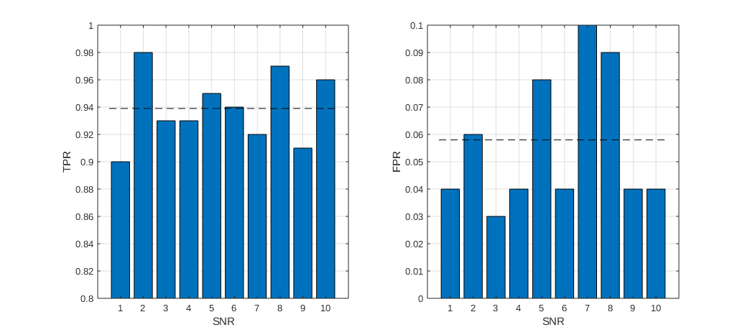
Models show good FPR and TPR
100 samples at each SNR value. In each case we record if p < 0.05 for either T (TPR) or prodicaine (FPR). Not perfect, but seems to work out OK throughout.

Slide 33
Next questions
For heritability
How do we distinguish true vs. spurious heritability estimates? Bootstrapping ρ will never cross zero.
How well can we estimate heritability of subject effects (e.g. placebo magnitude) when multiple heritable effects covary (e.g. intercept is likely to vary with all)?
For main effects
How well can we estimate main effects when we have unaccounted for confounds
For both
What’s the right way to model SNR given diverse objectives and multiple sources of error?
How well can we recover true effects when covariance structure is misspecified? (e.g. diagonal true covariance but modeled with full covariance structure, or vice versa)
How sensitive are estimates to normality assumptions? both for residuals and random effects.

Slide 34
Appendices

Slide 35
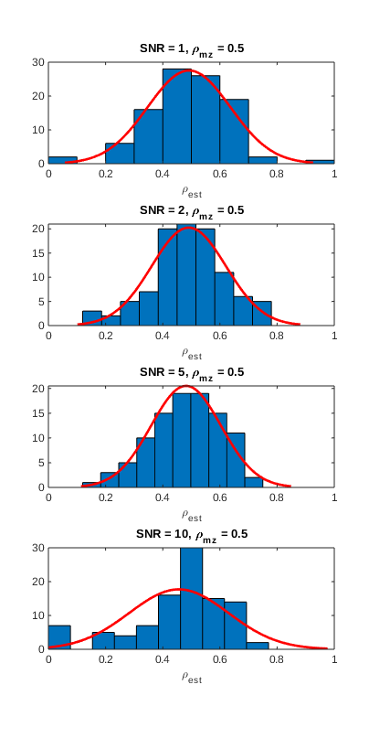
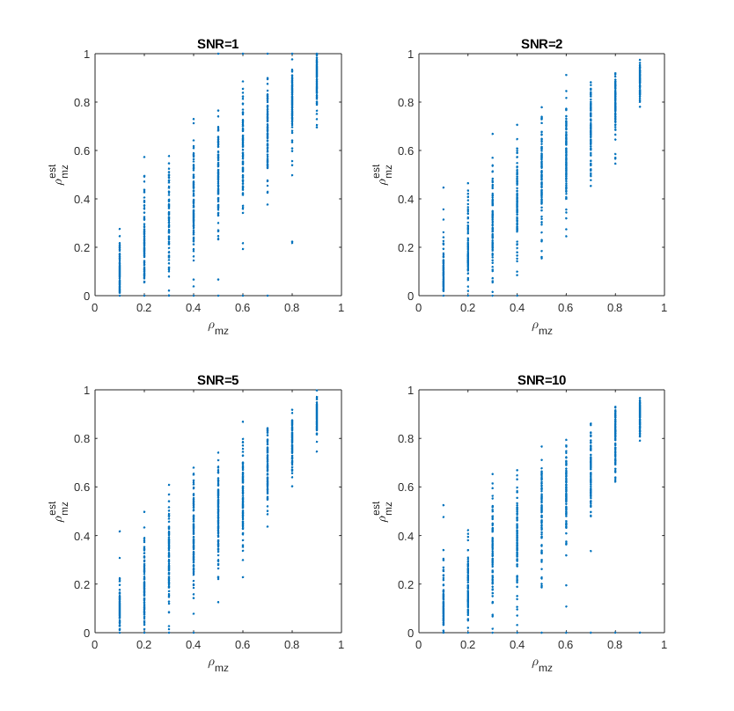
Estimating heritability with 50 families instead of 200
50 families
200 families

Slide 36
Mixed models with heteroscedastic error variance
These slides covered models with heteroscedastic random effects. If interested in heritability of subject level observations (rather than subject level estimates) you need a mixed model with heteroscedastic error variance.
Cannot be implemented in Matlab
Can be implemented in R using nlme with parameterized model weights.
Fitting heteroscedastic variance is equivalent to fitting a weighted regression with different weights for one group than the other, but without knowing what weighting to use. Parameterizing weights provides maximum likelihood solution.
Demo available here: https://m-clark.github.io/mixed-models-with-R/extensions.html

